Slide 1

Housing Data Analysis Dashboard
BY
KHALED ZAKI FAHIM
CAI1_DAT1_G1E
1120136065
SUPERVISED BY DR. ANAS ISMAIL, EGYPT UNIVERSITY FOR INFORMATION SCIENCE.

Slide 2
Project Introduction
This presentation is part of my training project for the Digital Egypt Pioneers Scholarship 2024, focusing on housing data analysis. The dashboard provides insights derived from real-world housing data to improve decision-making processes related to housing unit allocation and applicant prioritization.

Slide 3
Key Insights from Housing Data Analysis
1. Social Status Distribution
2. Unit Size Preferences
3. Current Residence Types
4. Educational Qualification Impact
5. Age Group Distribution
6. Allocation Status
7. Communication Service Usage

Slide 4
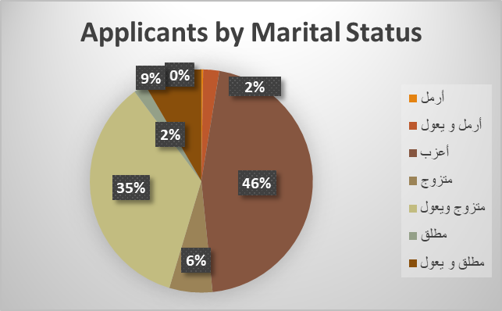
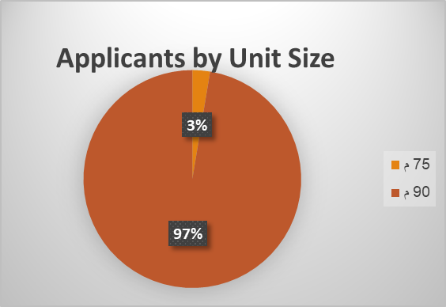
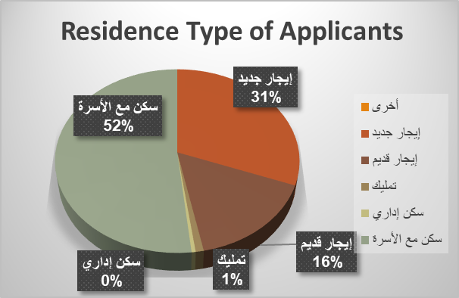
Studying Total Number of Applicants in Housing Projects
We will analyze this number based on the available data.
Total Number of Applicants
171990

Slide 5
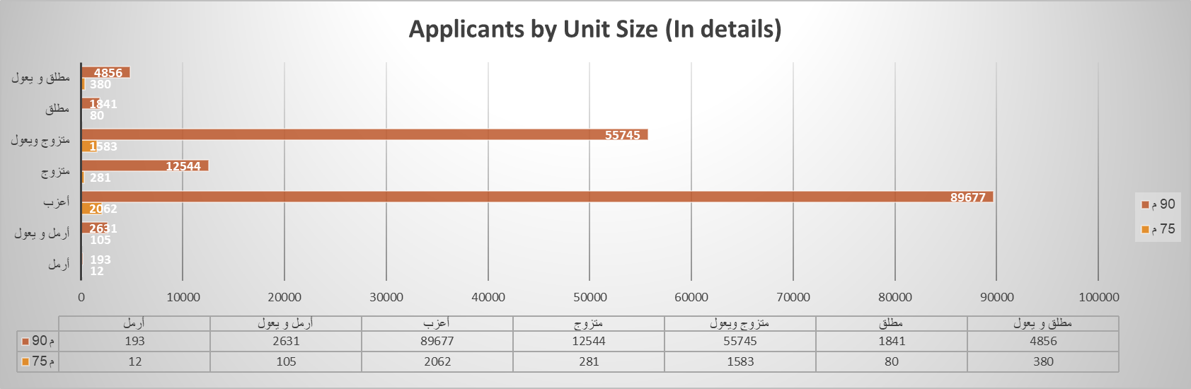
Applicants by Unit Size (In details)
This chart shows the number of applicants for the available housing units based on the unit size. It helps analyze the preferences of applicants for different types of available units.

Slide 6
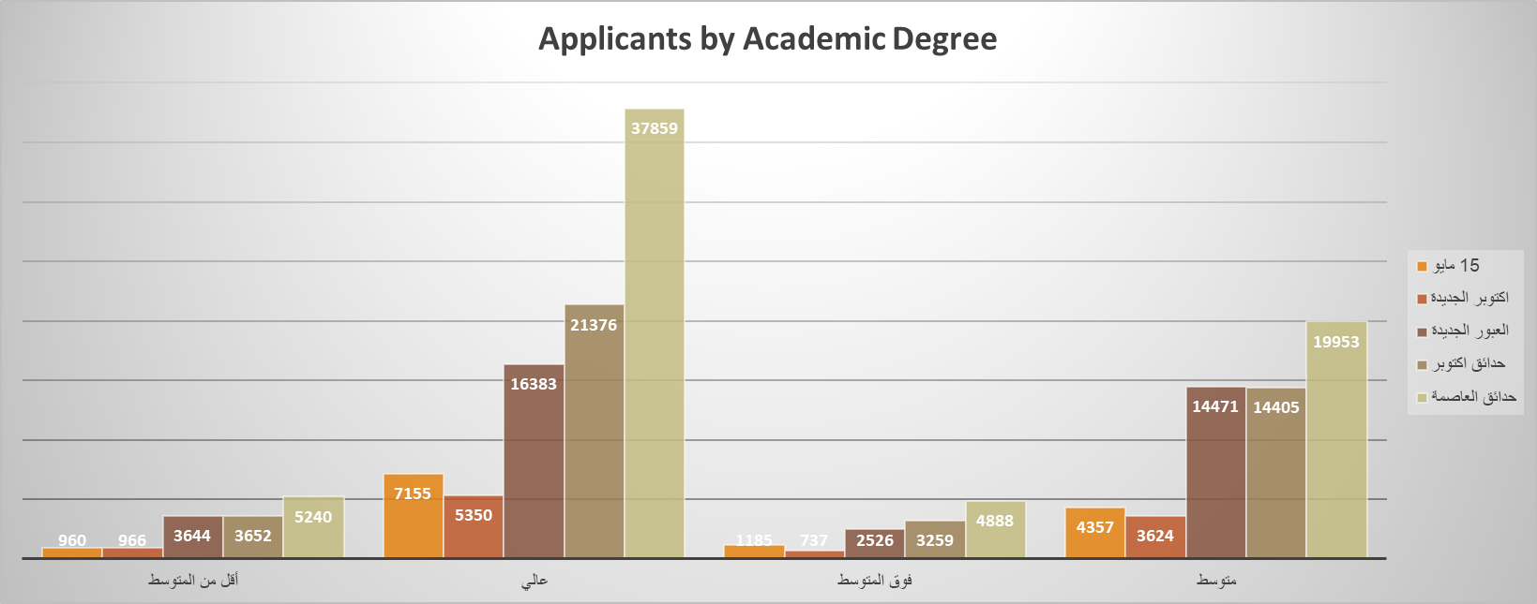
Applicants by Academic Degree
This chart shows the distribution of applicants based on their academic qualifications. It helps identify the role of educational background in applying for housing units, providing deeper insights into the applicants.

Slide 7
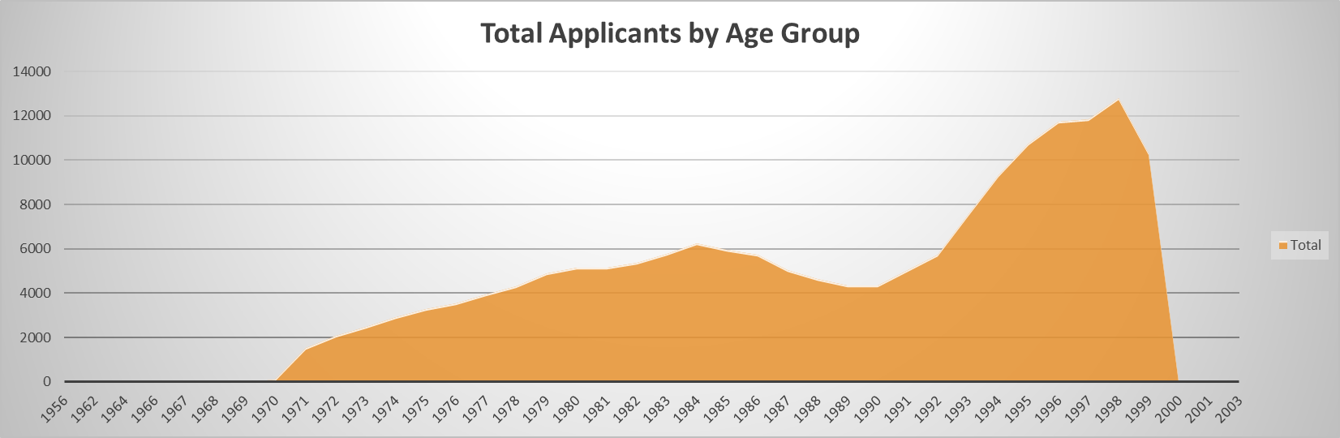
Total Applicants by Age Group
This chart displays the total number of applicants by age group. It helps analyze the different age groups benefiting from the housing units, aiding in planning to meet the needs of various age segments.

Slide 8
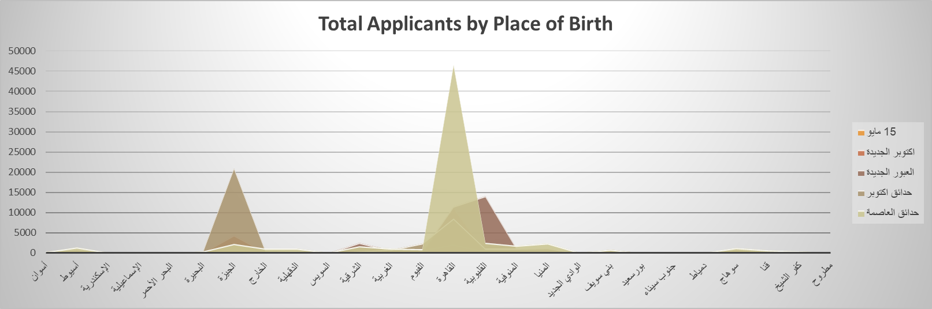
Total Applicants by Place of Birth
This chart displays the number of applicants based on their birth governorate. It helps understand the geographic distribution of applicants and identify the regions with the highest number of applicants.

Slide 9
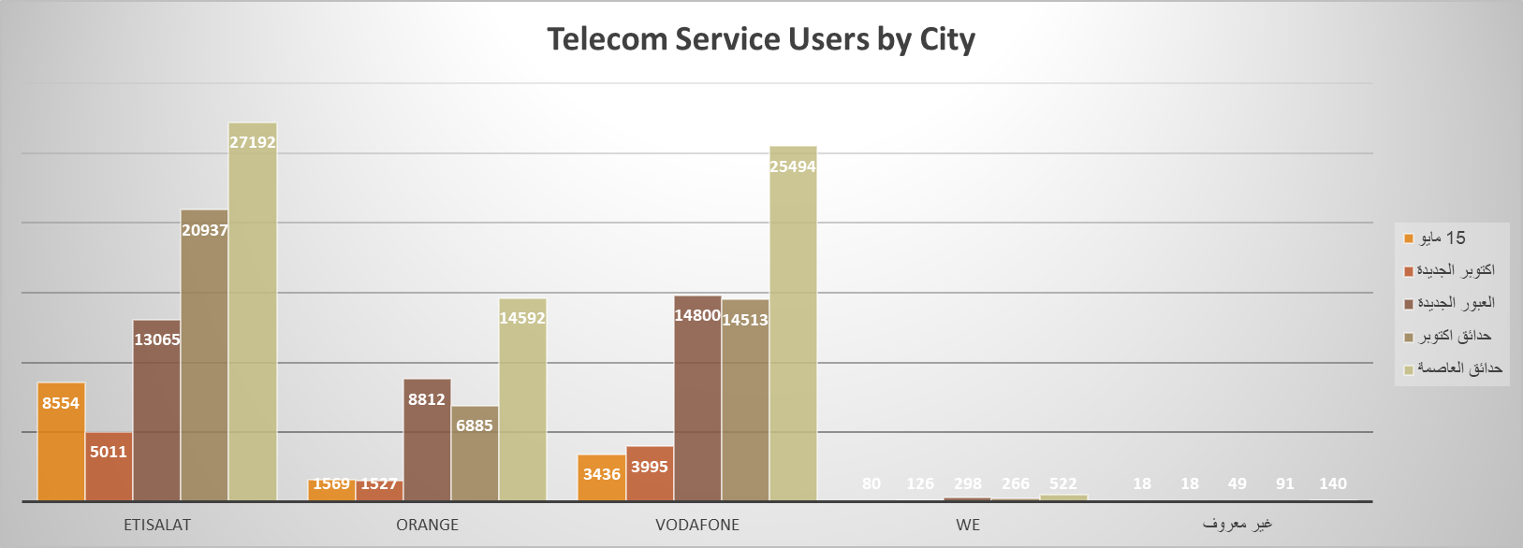
Telecom Service Users by City
This chart shows the number of applicants using different telecom services in each city. It provides additional data about the distribution of applicants based on telecom provider, which could be useful for improving services in new cities.

Slide 10

Allocated vs. Non-Allocated Applicants
This chart shows the number of applicants who have been allocated a housing unit versus those who have not been allocated a unit yet. It helps track the progress of the allocation process and determine if demand is being met.

Slide 11
Conclusion
In summary, our analysis of housing project applicants provides valuable insights into demographic trends and preferences.
This information can aid policymakers and stakeholders in making informed decisions regarding housing allocations and support initiatives.
Thank you for your attention!
If you have any questions, feel free to ask.

